Slide 1
SWISS RE OVERVIEW, INCIDENT AND PROBLEM MANAGEMENT
- Jyoti Agrawal

Slide 2

OVERVIEW
Swiss Reinsurance Company founded in 1863.
Based in Zurich, Switzerland.
World’s second largest reinsurer, Asset management.
Acquired GE insurance solutions(2002)
Renamed Swiss Re(2006)

Slide 3
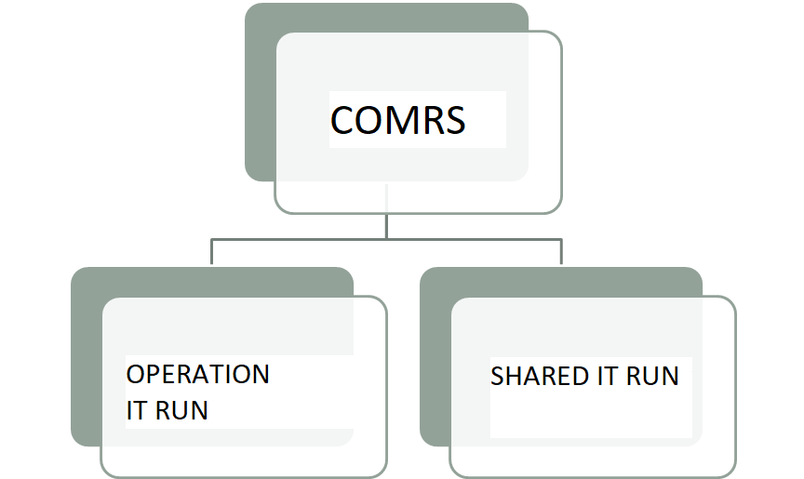
CONTRACT HIGHLIGHTED

Slide 4

..CONTINUED
Merged and named as CEDD operation Team.
OBJECTIVE OF COMRS: To provide a single window for the application.
Support Model focuses on customer outcome and better services.
Optimized RUN services.

Slide 5
…CONTINUED
L1.5 Team –
Initial incident triaging.
Do analysis and assign tickets to L2 or L3 team.
Contact L2 or L3 team when no workaround is available.
L2 Team –
Resolve incident and problem ticket passed by L1.5 team.
Cannot do codebase change.
Can contact L3 team when required.
L3 Team –
Detailed analysis and code changes.
Enhancement and changes to the application after approval.

Slide 6
Incident Management
L1(Contact One) -> L2 -> L3
Triage / Acknowledge
Check for the type of ticket
In progress
Resolved & Update KB’s
Close

